Slide 1

How To Pay For College
Presented by:
Amy Neathery
The Arkansas Student Loan Authority

Slide 2
Types of Financial Aid
Gift aid: Grants and Scholarships
(need-based or merit-based)
Self-help aid: Loans and Employment (need-based or non need-based)

Slide 3

Federal Student Aid
Free Application for Federal Student Aid
FAFSA

Slide 4
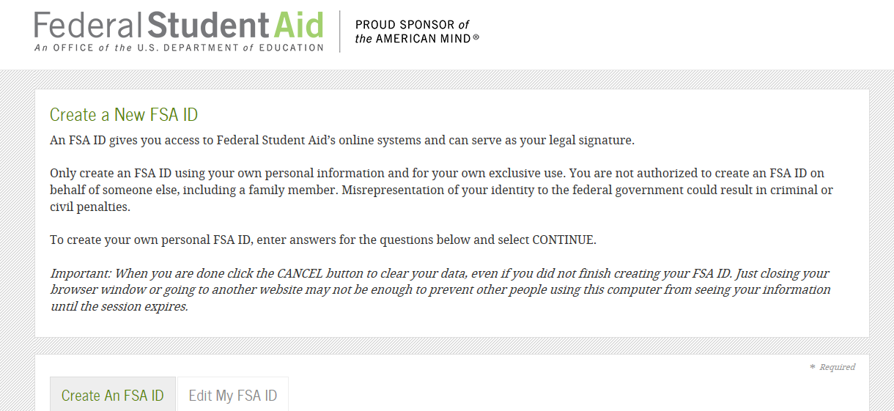
Federal Student Aid
  https://fsaid.ed.gov

Slide 5
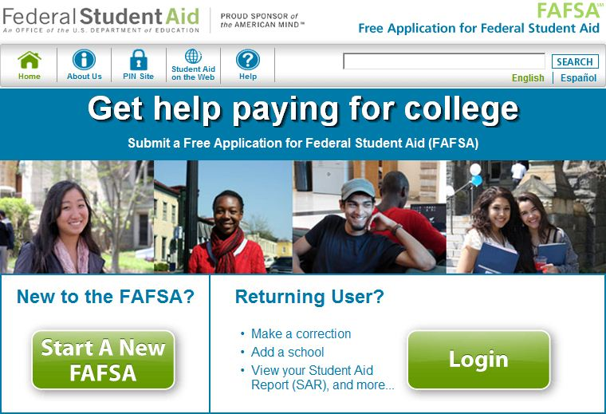
Federal Student Aid
www.fafsa.ed.gov

Slide 6
Step 1: Federal Student Aid
Collect the documents needed to apply for federal aid. A full list of what you need is at www.fafsa.gov.
Social Security numbers and birthdates (student and parent/guardian)
Driver’s License number
Alien Registration number (if not a US citizen)
Federal Tax Information (student and parent/guardian) – Can use Data Retrieval Tool
Records of untaxed income – Social Security, Child Support, Interest Income, Welfare, Temporary Assistance to Needy Families, Veterans Benefits
Information on cash; savings & checking account balances;investments; business & farm assets;
Keep these records! You may need them again. IF THERE IS A CHANGE IN INCOME DUE TO JOB LOSS, FAMILY EMERGENCY, MEDICAL COSTS, ETC. YOU WILL NEED TO CONTACT THE FINANCIAL AID OFFICE OF THE COLLEGE(S)/SCHOOL(S) TO WHICH YOU HAVE APPLIED.

Slide 7
Step 2: Federal Student Aid
Complete the 2018-2019 FAFSA
Apply at www.fafsa.gov.

Slide 8
Step 3: Federal Student Aid
The U.S. Department of Education will send you your Student Aid Report (SAR) – the result of your FAFSA.
Review your SAR and, if necessary, make changes or corrections and submit your SAR for reprocessing.
Your complete, correct SAR will contain your Expect Family Contribution (EFC) – the number used to determine your federal student aid eligibility.

Slide 9
Step 4: Federal Student Aid
The school that you plan to attend might request additional information from you.
Be sure to respond by any deadlines.
The school will send you an award letter on how much aid you can get at that school.

Slide 10
Step 5: Federal Student Aid
Review award letters from schools and compare amounts and types of aid being offered.
Decide which school to attend based on a combination of (a) how well the school suits you needs and (b) its affordability after all aid is taken into account.

Slide 11
IRS Data Retrieval Tool
The IRS Data Retrieval Tool allows students and parent to access the IRS tax return information needed to complete the FAFSA, and transfer the data directly into their FAFSA From the IRS Website.
If you choose not to use the IRS Data Retrieval Tool to retrieve tax information, your school may require a copy of your IRS Tax Return Transcript.

Slide 12
How Much Federal Student Aid Can You Receive?
In general, it depends on your financial need.
Cost of Attendance (COA) is tuition, fees, room and board, transportation, etc.
Expected Family Contribution (EFC) is determined from the information reported on the Free Application for Federal Student Aid (FAFSA)
Financial Need = COA – EFC

Slide 13
Who Can Get Federal Student Aid?
U.S. citizen or (usually) permanent resident
Valid Social Security number
Males registered for Selective Service
High school graduate/GED holder
Eligible degree/certificate program
Satisfactory academic progress

Slide 14
Cost of Attendance
Tuition, fees, room & board
Books, supplies, transportation, & misc. personal expenses, including documented cost for a personal computer
Loan fees
Study abroad or cooperative program costs
Dependent care expenses
Disability-related expenses

Slide 15

Free Application for Federal
Student Aid (FAFSA)
  Paper Application at Student’s request
    2 - 3 weeks process time
  On-line (www.fafsa.gov)
    72 Hours

Slide 16
Free Application for Federal Student Aid (FAFSA)
Use FAFSA on the Web Worksheet to prepare. (Optional)
  Download a copy of the worksheet at: www.FederalStudentAid.ed.gov/worksheet
  Use the checklist to gather documents you need.
  Fill out worksheet to prepare your answers prior to completing the FAFSA on the web

Slide 17
Federal Student Financial Aid Programs
Federal Pell Grant
Federal Supplemental Educational Opportunity Grant (FSEOG)
Teacher Education Assistance for College and Higher Education (TEACH)
Academic Competitiveness Grant
National SMART Grant
Federal Work-Study Program

Slide 18
Federal Student Financial Aid Programs
Federal Perkins Loan
Federal Subsidized Stafford Loan
Federal Unsubsidized Stafford Loan
Federal PLUS Loan
Federal Graduate PLUS Loan

Slide 19
Independent Student Definition
At least 24 years old by Dec. 31 of award year
Graduate or professional student
Married
Provides more than half support for dependents
Orphan or ward/dependent of the court
Veteran of U.S. Armed Forces
Determined to be “independent’ by financial aid administrator based on unusual circumstances

Slide 20
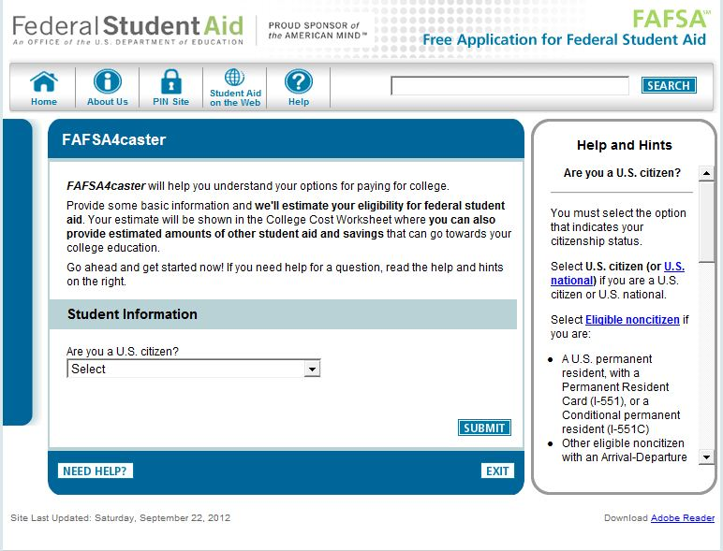
www.fafsa4caster.ed.gov
www.fafsa4caster.ed.gov

Slide 21
Scholarship Searches

Slide 22
Tips for Successful Scholarship Searches
Create a Scholarship Deadline calendar
  Start the process two years before you need aid
  Remember you will be applying for scholarships one year before you actually receive the aid
  Maintain good grade average
  Take or retake ACT/SAT

Slide 23


Standardized Test Preparation
www.number2.com
www.march2success.com

Slide 24
Tips for Successful Scholarship Searches
  Design a Personal Resume to market yourself
  List participation in campus & community leadership and civic activities
  Identify qualities that make you distinct
  Physical conditions or family situations may have a corresponding scholarship

Slide 25
Scholarship Resources
Financial Aid Officer
Scholarship Office
Guidance Counselor
Public Library
Civic Organizations
Church
Corporations & Businesses
Internet
  Free Online Searches
  Set Up Google Alerts

Slide 26
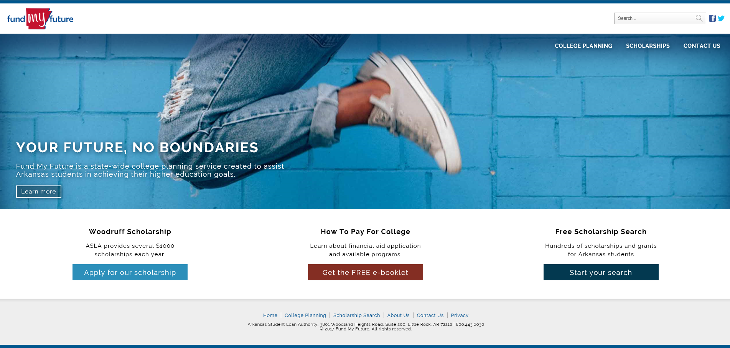
www.fundmyfuture.info

Slide 27
Scholarship Application Process
  Read all eligibility & requirement information; ask questions if necessary
  Gather all required information
  Know deadlines
  Double check completed application
  Ask someone to proofread applications & essays
  Send completed application (& essays )

Slide 28

YOUniversalFinancial Aid System
One location where you answer a few questions to see what programs might be available to you from all Arkansas state and lottery funded scholarships, grants and loan reimbursements:

Slide 29
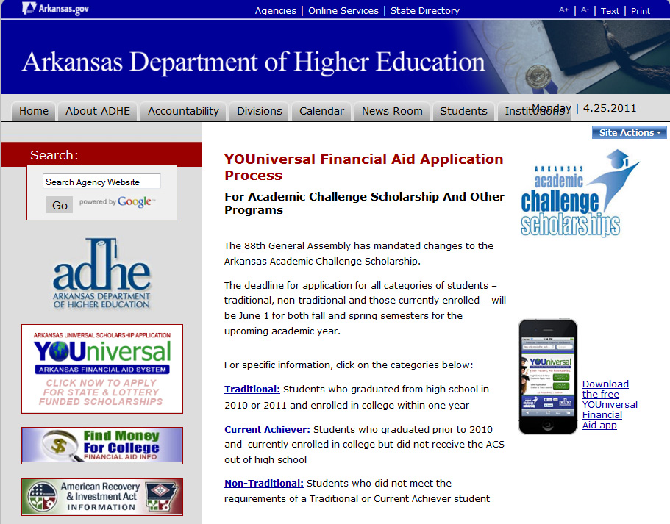
Apply at ADHE.EDU for State Financial Aid

Slide 30

YOUNIVERSAL Application Homepage

Slide 31
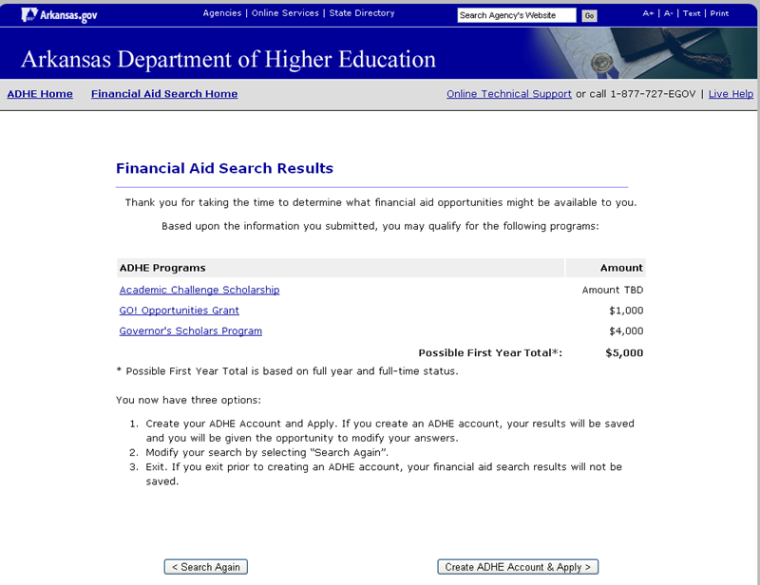
Example Search Results

Slide 32


Arkansas State Scholarships & Grants
AR Academic Challenge Scholarship
AR Governor’s Scholars Program
AR Future Grant

Slide 33
Academic Challenge Scholarship
The Basics:
  Mostly funded by lottery proceeds
  Open to ALL: Scholarship may be used by Traditional, i.e. incoming high school students, and all other students
  No income limits but must file FAFSA as part of the application process
  Scholarship is for those enrolled in a first baccalaureate, associate, qualified certificate, or nursing diploma program

Slide 34
How To Qualify As A High School Senior
If graduating from an Arkansas public high school:
  19 composite ACT score (or equivalent score on an equivalent test)

Slide 35
How To Keep Your Scholarship
  Enroll full-time (12 semester hours first semester and 15 semester hours thereafter)
  Maintain a 2.50 cumulative GPA
  Complete 27 semester hours the first academic year and 30 semester hours each year thereafter
  Complete all remedial coursework during the first 30 hours taken after receipt of the scholarship
  Enroll in courses that lead toward a Bachelor’s degree after attempting the lesser of:
    66 semester hours
    Completion of an associate degree program
  Renewed annually until recipient first:
    Earns Bachelor’s degree
    8 semesters
    Non-traditional students determine when awarded

Slide 36
Academic Challenge Key Points
Deadline for all categories – both spring and fall semester – is June 1st
Students receiving the Academic Challenge Award:
4 Year Institutions
$1,000 freshman year
$4,000 sophomore year
$4,000 junior year
$5,000 senior year
2 Year Institutions
$1,000 freshman year
$3,000 sophomore year

Slide 37
Governor’s Scholars Program
Scholarship programs that encourages Arkansas’s best & brightest high school students to remain in Arkansas for their college education
  Governor’s Distinguished Scholarship (up to $10,000 per year)
    32 ACT or 1410 SAT; and
    3.5 GPA; or
    National Merit or National Achievement Finalist
    300 new Governor’s Distinguished Scholars awards may be awarded each year.

Slide 38
Governor’s Scholars Program
Scholarship programs that encourages Arkansas’s best & brightest high school students to remain in Arkansas for their college education
  Governor’s Distinguished Scholarship
    The highest achieving student in counties that do not have a qualified Governor’s Distinguished recipient will be awarded the Governor’s Scholars for $5,000 per year. Applications will be pulled from Academic Challenge after the application deadline date to determine Governor’s Scholars awards.
    Deadline to apply is February 1st.

Slide 39
AR Future Grant
Designed to promote higher education, increase the skills and education of Arkansas’ workforce and attract students into a high-demand, high-wage occupation.
The grant will cover tuition and fees for qualifying Associate and Certificate programs at public institutions for eligible students.

Slide 40
AR Future Grant
Who Is Eligible?
  Graduated from an Arkansas high school, Arkansas homeschool, or GED program
  Anyone who has a high school diploma and has lived in Arkansas for the last three years.
  Students Must:
  Enroll in a regional high demand or STEM program
  Not already earned an Association or higher degree
  Complete the FAFSA

Slide 41
AR Future Grant
Every student must receive monthly mentoring, complete 15 hours of community service per semester, and maintain Satisfactory Academic Progress.
Once a student becomes a graduate, the recipient must work in Arkansas for 3 years.
Deadline to apply is June 1st.

Slide 42
ADHE Website and E-mail Address
www.adhe.edu
Financial Aid Division
Or send an email to:
finaid@adhe.edu

Slide 43
Don’t forget to:
Create a Calendar for deadlines
Read your all of your mail and email
Know what your scholarship will pay for & how to maintain eligibility
Communicate with scholarship providers
If you have questions, ask a financial aid professional or call ADHE

Slide 44

There’s a world of scholarships available…

Slide 45

















Slide 46














Slide 47

Contact Information
Arkansas Student Loan Authority
Fund My Future
1-800-443-6030
www.asla.info
www.fundmyfuture.info

Slide 48
Questions?

